Slide 1

Coronavirus Misinformation on Reddit
Austin Lee

Slide 2
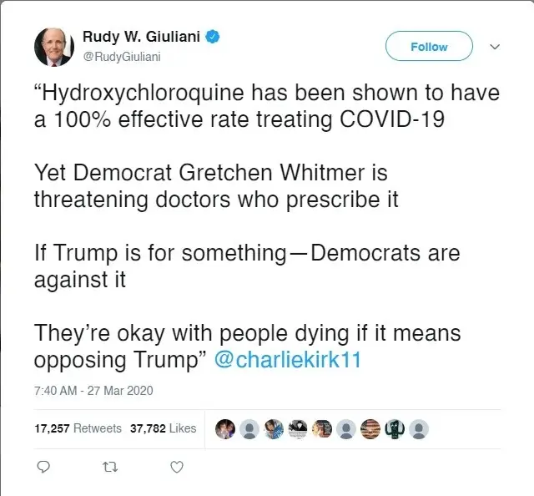
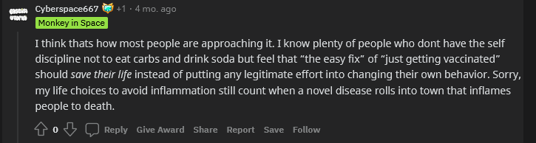
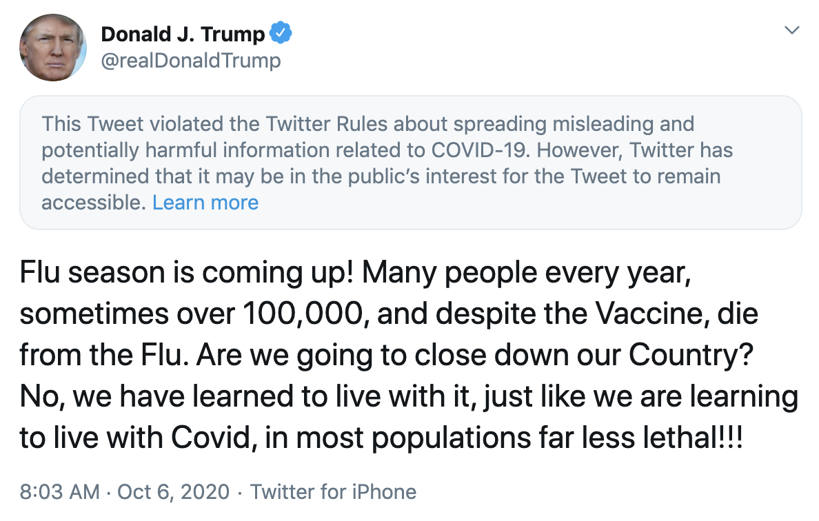
The Problem:
https://www.buzzfeednews.com/article/ryanhatesthis/twitter-deleted-tweets-brazil-president-coronavirus
https://www.reddit.com/r/JoeRogan/comments/r7tbhz/deleted_by_user/hn2kb4z/
https://fas.org/blogs/fas/2020/10/most-covid-related-disinformation-on-social-media-likely-emanating-from-known-influencers-and-traditional-media-sources/

Slide 3

Reddit
3.1 million subreddits
Community moderated
52 million daily users
303.4 million posts and 2 billion comments, 2020

Slide 4
Estimated Reddit Posts/Comments between 2018 and 2020

Slide 5
My Project
Goal: Can I build a way to classify and quantify potential coronavirus misinformation comments over different subreddits? Then, can I determine the users’ sentiments regarding the post?

Slide 6
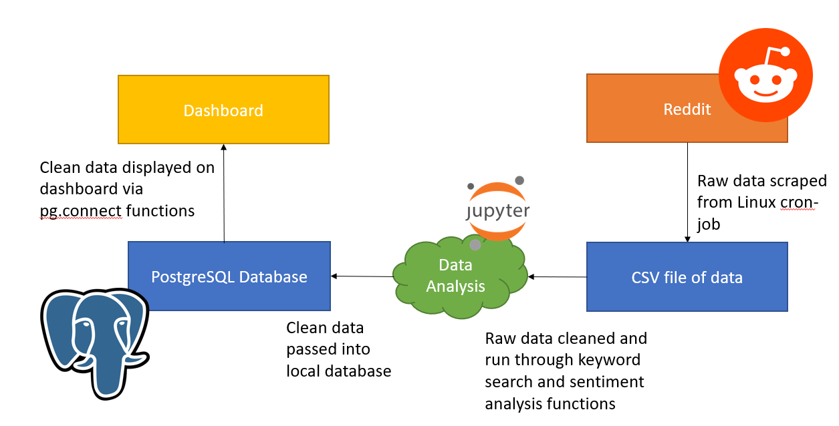
System Diagram

Slide 7

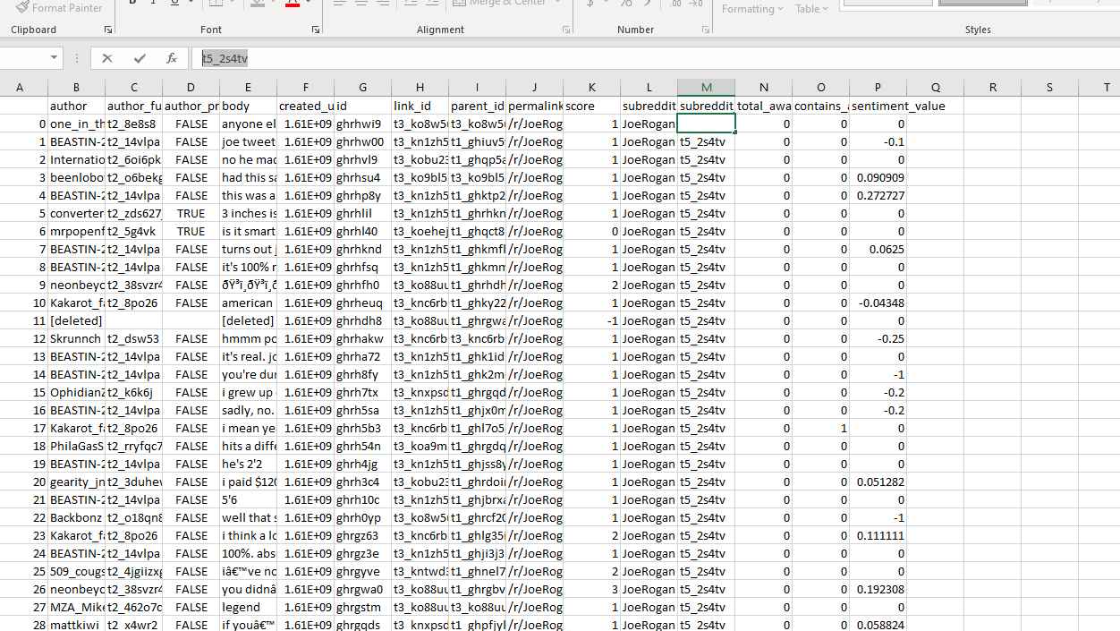
Data Scraping
Dataset 1
Linux cron job
Collected data every hour from 11 subreddits in real time
Does not include score/upvote data
Dataset 2
Collected data between Jan 2021 and Sept 2021
Pushshift retroactively collects score/upvote data
Also 11 subreddits
https://www.servethehome.com/red-hat-enterprise-linux-7-5-hits-general-availability/

Slide 8
What a single datapoint looks like
Author
username
Author_fullname
t2_8e8s8
Author_premium
boolean
Body
Body of comment, ei “vaccines are bad”
Created_utc
Time when comment was posted
ID
Id of post, ie “ghrhwi9”
Link_id
t3_ko8w5u
Parent_id
t1_ghiuv5y
Permalink
/r/JoeRogan/comments/ko8w5u/daily_general_discussion_january_01_2021/ghrhwi9/
Score
Upvote data, numeric value
Subreddit
politics
Subreddit_id
t5_2s4tv
Total_awards_received
Numeric value

Slide 9
What I collected
Subreddit | Number of Comments (Set 1) | Unique Authors (Set 1) | Number of Comments (Set 2) | Unique Authors (Set 2)
r/JoeRogan | 56000 | 18719 | 89985 | 19771
r/walkaway | 54048 | 9855 | 17408 | 5203
r/ukraine | 21462 | 3581 | 1528 | 915
r/Coronavirus | 56000 | 20765 | 24356 | 9457
r/antiwork | 56000 | 21844 | 463880 | 144249
r/politics | 54000 | 31060 | 383805 | 103474
r/Conservative | 54000 | 16602 | 317 | 199
r/ progressive | 7630 | 1710 | 174 | 134
r/ Libertarian | 54000 | 12206 | 42316 | 6971
r/conspiracy | 56000 | 18499 | N/A | N/A
r/ AskThe_Donald | 34412 | 5458 | N/A | N/A
r/HermanCainAward | N/A | N/A | 57325 | 13817
r/WorkReform | N/A | N/A | 45946 | 13817
Total | 503552 | 143116 | 1127040 | 283558

Slide 10
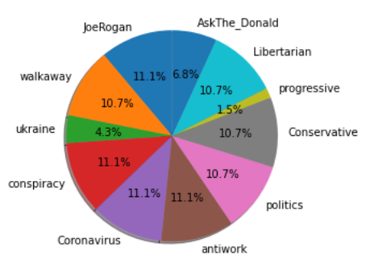
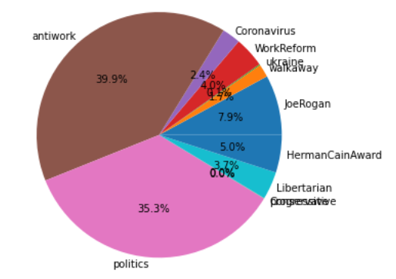
Comments Distribution
Dataset 1 (non-cron job dataset)
Dataset 2

Slide 11
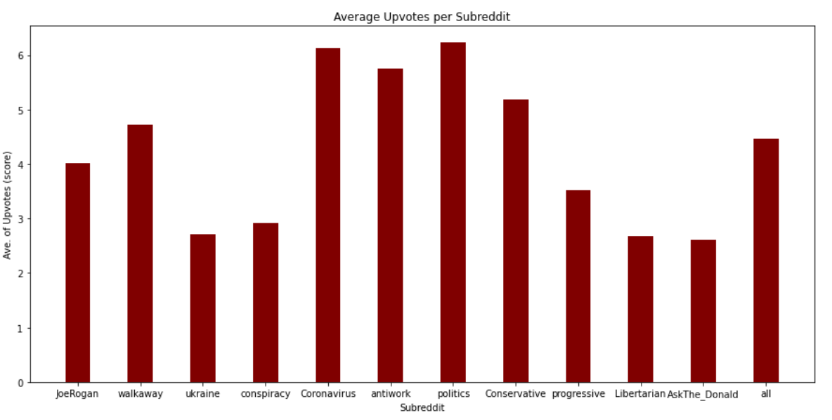
Upvote data (dataset 1)

Slide 12


Data Analysis
Used a combination of keyword search and sentiment analysis
https://www.collinsdictionary.com/us/dictionary/english/dictionary
https://python.plainenglish.io/introduction-to-nltk-library-in-python-6fa729b54ad

Slide 13
Keyword Search
Used to flag data
Dictionary contained 37 terms including different names for coronavirus and misinformation buzzwords
Ie “covid-19”, “rona”, “kung flu”
Dataset 1:
Flagged 69733 posts or about 6.18% of the dataset
Dataset 2:
Flagged 86307 posts or about 17% of the dataset

Slide 14
Sample of Keywords
Term | Comments Present (Dataset 1) | Percent of Data (Dataset 1) | Comments Present (Dataset 2) | Percent of Data (Dataset 2)
coronavirus | 1738 | 0.003451 | 636 | 0.000564
corona | 2037 | 0.004043 | 803 | 0.000712
covid-19 | 2172 | 0.004313 | 1069 | 0.000948
covid | 12089 | 0.024007 | 16490 | 0.014631
vaccine | 14112 | 0.028024 | 7115 | 0.006312
virus | 6012 | 0.011939 | 3070 | 0.002723
vaccinated | 6037 | 0.011988 | 3985 | 0.003535
hydroxychloroquine | 76 | 0.000151 | 74 | 0.000006
jab | 538 | 0.001068 | 447 | 0.000396
ivermectin | 224 | 0.000448 | 698 | 0.000619
hoax | 356 | 0.000707 | 424 | 0.000376
china | 3632 | 0.0072127 | 3788 | 0.0033610
china flu | 15 | ~0 | 3 | ~0

Slide 15
Quick Findings
Dataset 1:
Most flagged keyword was “covid” in 16490 comments
Dataset 2:
Most flagged keyword was “vaccine” in 14112 comments

Slide 16

Sentiment Analysis
Determine the user’s sentiment surrounding the post
Positive or negative?
4 Steps
Tokenize data
Remove stop words
Lemmatize
Run sentiment analysis function
https://www.thehumancapitalhub.com/articles/Employee-Sentiment-Analysis-And-What-You-Need-To-Know

Slide 17
Tokenize Data
Break body of comment down into an array of strings
Each value will eventually have a sentiment value associated with it
Used NLTK’s tokenizer functions

Slide 18
Remove Stop Words
Stop words are words like “in”, “the”, and “of”.
These words do not add much to overall meaning of the sentence
Scrubbed the array using spaCy/en_core_web_sm’s default stop word list

Slide 19
Lemmatize
Breaks words down to their roots
For example, the word “comes” turns into “come”
Used NLTK’s WordNetLemmatizer() function for this process

Slide 20


Sentiment Analysis Function
Used NLTK’s pre-trained sentiment analysis tool, VADER
Computes polarity of each word in a post
-1 = negative sentiment
1 = positive sentiment
0 = neutral
For example, the text “vaccines are good”, may receive a [0, 1] sentiment score array, since “vaccines” is neutral, “are” is a stop word, and “good” is positive
https://realpython.com/python-nltk-sentiment-analysis/
https://www.digitalspy.com/tv/ustv/a39400041/obi-wan-darth-vader-first-look-photo/

Slide 21

Sentiment Analysis Function
Took the average sentiment value of each word in the post to determine the overall sentiment of the full comment
Idea is if posts containing the term “ivermectin” are positive, then it can be inferred that pro-ivermectin information is being passed around
Assumes that you know the word is associated with misinformation
https://www.nytimes.com/2021/08/30/health/covid-ivermectin-prescriptions.html

Slide 22
Sentiment Analysis Function

Slide 23

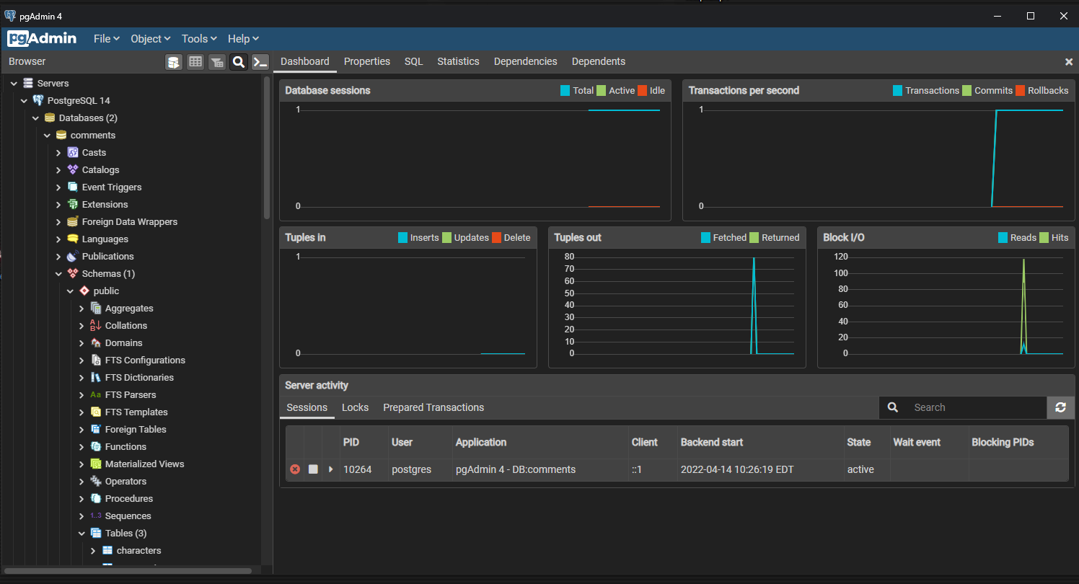
Database
Finally, after analysis, the data is passed into the PostgreSQL database
Opensource relational database management system
Used pgadmin GUI tool
https://en.wikipedia.org/wiki/PostgreSQL

Slide 24


Dashboard
PostgreSQL database linked up to web interface to present data
Built using XAMMP (windows) and MAPP (Apple) stack
Currently local, running using php, html, python, JavaScript
https://en.wikipedia.org/wiki/XAMPP
https://bitnami.com/stack/mapp

Slide 25
Live Demo

Slide 26


Future Work
Bigger dataset
Longer time period with more posts
Additional subreddits and better keyword search (potentially found using TF-IDF methodology)
Additional methods for catching misinformative posts
Machine learning algorithm for big datasets, Word2Vec
Dashboard improvements
Human assisted classifier for ML dataset
Real time pipeline
Ajax framework
https://www.w3schools.com/whatis/whatis_ajax.asp
https://www.forbes.com/sites/kalevleetaru/2019/01/15/why-machine-learning-needs-semantics-not-just-statistics/?sh=79b2f94877b5

Slide 27
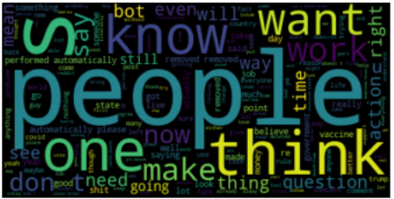
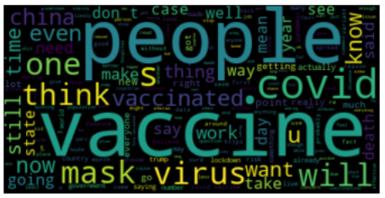
Word clouds
Full dataset
Flagged Comments

Slide 28
Thanks!

